Slide 1
Viola Jones Algorithm HAAR CASCADE
by Bekenova Aruzhan Buranovna

Slide 2
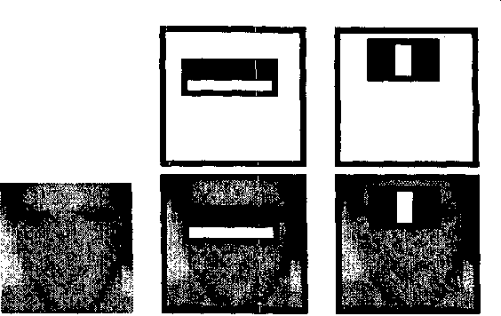
"How do I detect objects in an image?"
Modern systems often use deep learning, but in practice many devices and programs still use an older but effective method developed in the early 2000s.
Before the advent of powerful neural networks, researchers developed machine learning algorithms with manual features, small neural networks, and other classifiers.

Slide 3
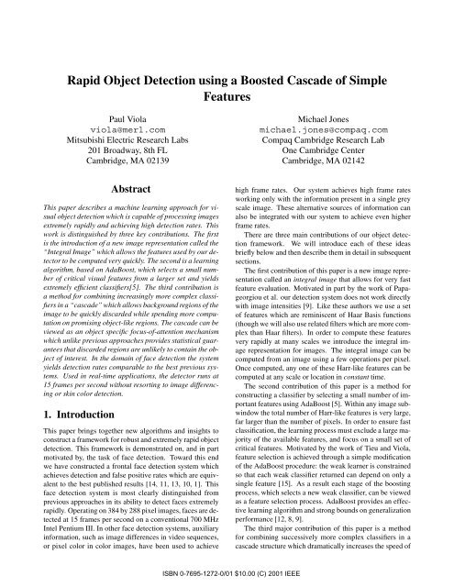
In 2002, Paul Viola and Michael Jones presented the article "Rapid Object Detection using a Boosted Cascade of Simple Features".
This work had a huge impact: more than 17,000 citations.
Despite the development of deep learning, the Viola-Jones algorithm still remains relevant due to its speed and efficiency.

Slide 4
The algorithm was originally designed to detect faces. Despite the fact that it has lower accuracy than modern face detection methods based on convolutional neural networks (CNN), the Viola-Jones algorithm is still an effective solution for devices with limited resources.
The Viola-Jones algorithm is based on four basic ideas:
Haar-like features
Integral images to speed up the calculation of features
AdaBoost training for feature selection
Cascade of classifiers for fast rejection of windows without faces.

Slide 5
What are Haar features?
The Viola-Jones algorithm uses a set of features similar to Haar wavelets, which are a set of square-shaped functions.

Slide 6
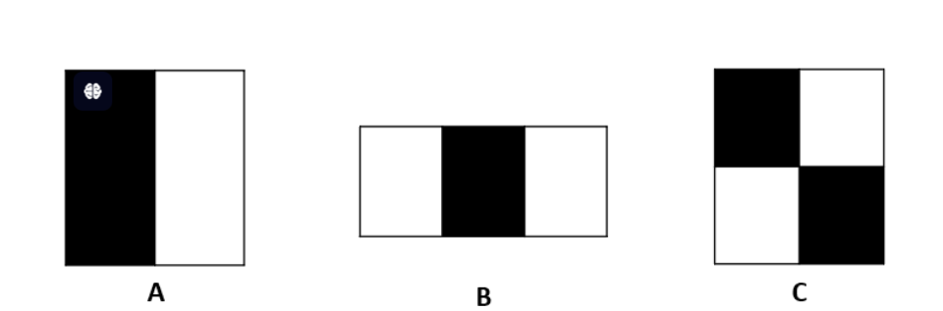
More specifically, the algorithm uses three types of Haar features, shown in the following figure:
Each function defines a set of rectangles in the image window. The rectangle can be marked as white or black. The value of the function is calculated as the difference between the sum of the pixel values in the white areas and the sum of the pixel values in the black areas.The value of the feature will be near zero for "flat areas", i.e. where all pixels have the same value. A large value of the feature will be obtained in areas where the pixels in the black and white rectangles are very different.

Slide 7
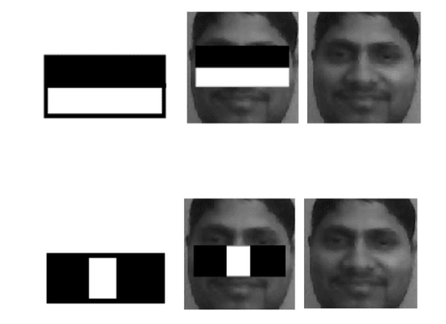
As shown below, signs A and B are of great importance in face recognition because:
the eye area is darker than the cheeksthe
eye area is darker than the nose area

Slide 8
Integral image
An integral image is a data structure for efficiently calculating the sum of pixel values in a rectangular image window. Consequently, Haar features can be calculated very quickly using the integral representation of the image.
The integral image can be calculated in one pass from image I using the following equation:

Slide 9
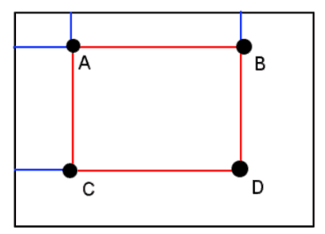

It can be shown that the sum in any rectangular area requires four integral image values, regardless of the window size.:
More specifically, the sum of the pixel values inside the rectangle ABCD shown above can be calculated as follows:

Slide 10
Learning with AdaBoost
The number of features is approximately 16,000 if the basic resolution of the detector is 24x24. However, a small number of these features are useful for detecting faces. The Viola-Jones algorithm uses AdaBoost to find the best features and train the classifier. Each feature of the Haar type is a weak classifier. The final classifier is given by a linear combination of weak classifiers. Higher weights are associated with the best classifiers using the AdaBoost learning algorithm.

Slide 11
Cascade of attention
The attention cascade is another technique of the Viola—Jones algorithm that allows you to increase the detection rate.The best feature selected by AdaBoost rejects many negative windows while detecting almost all positive windows. Therefore, the classifier corresponding to the best feature is evaluated first in this window.
A positive response triggers the evaluation of a second (more complex) classifier, and so on. A negative response at any level leads to a rejection of the window.

Slide 12
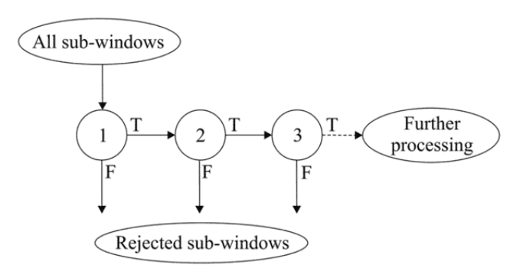
This strategy rejects as many negative windows as possible at the earliest stage. Only positive instances trigger all classifiers in the cascade.
The following figure schematically shows the detection cascade:

Slide 13
Conclusions
The Viola-Jones algorithm, an efficient machine learning approach for object detection, has been reviewed. Four key concepts forming the foundation of this technique have been explained.

